Slide 1
Modi C Wash
Business Pitch

Slide 2
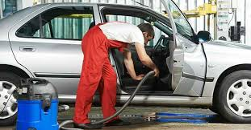
EXECUTIVE
Mobi C Wash is run by the owners who have had a credible experience in the car wash industry.
The car was business will be taken to the location of the comfort of the consumers.
The business will be providing services as a full package and limited package for certain prices and time and comfort of the consumers.

Slide 3
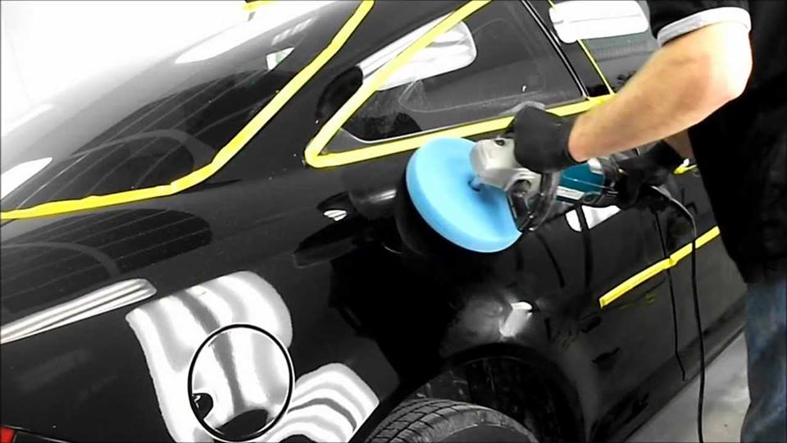
Continuation
Interior car washing
Exterior car washing
Detailing
Full wash
Car dealership
Business fleet washes

Slide 4
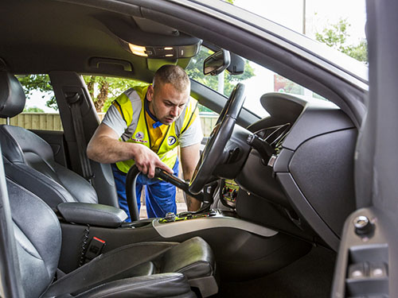
Market Positioning
There are many car wash service on the market but few are personalized and mobile.
The rigidity of the car wash services around and busy schedules of consumers deny them the time to take their vehicles for a clean-up.
These services should be provided with different platforms such a mobile-based apps and web-based app s and hot numbers that are readily available to the consumers.

Slide 5
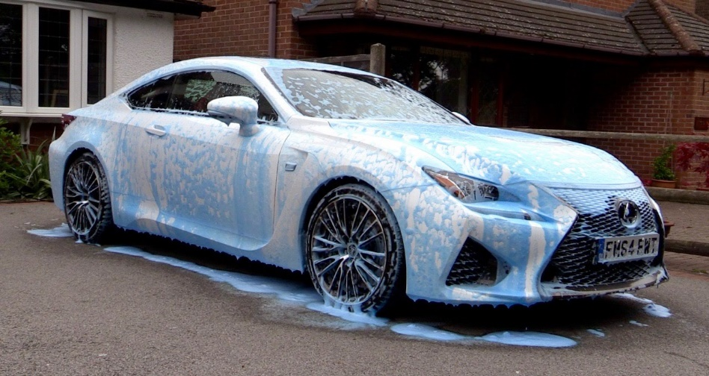
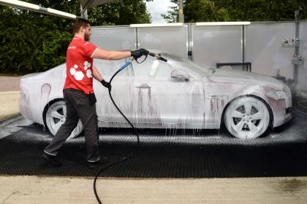
Product positioning
There is over a billion user of personal cars in the world, and the number increases by the day.
The services will be detailed for the corporate and individual car owners.
The Mobi C Wash will service new car owners, elder luxury car owners, lifetime owners, sport car owner and new and used car owners

Slide 6
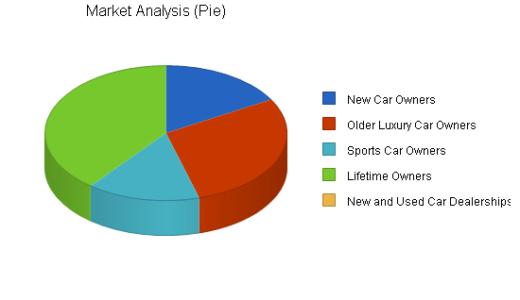

Slide 7
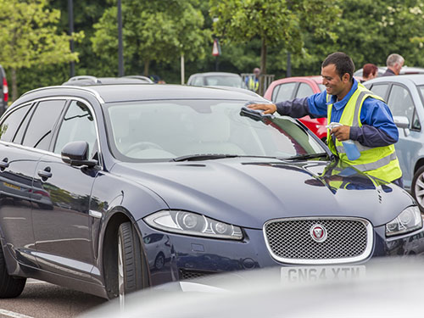
Business Networks
Modi C Wash will make strategic partnerships in the business of car wash industry.
Business will partner with key car washing small business in different areas to reach the market segment demands in areas far from our main braches.
The business will also partner with the water companies in and water providers in the many townships and municipals.
The company will also partner with the government and private entities that will be of strategic advantage.
The most important network however of Mobi C Wash will be that of the business and its consumers through its service platforms.

Slide 8
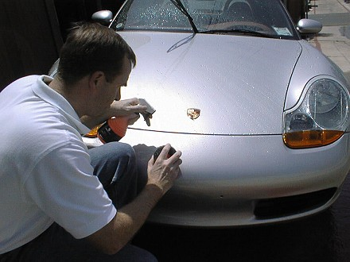
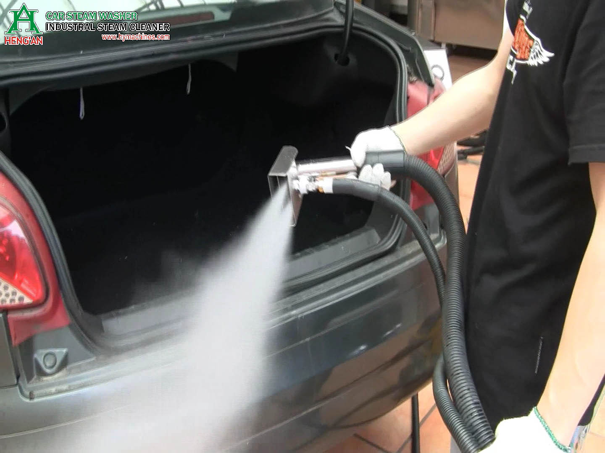
Competition
New segment.
No existing competition.
But there will be competition from new entrants in the market.

Slide 9
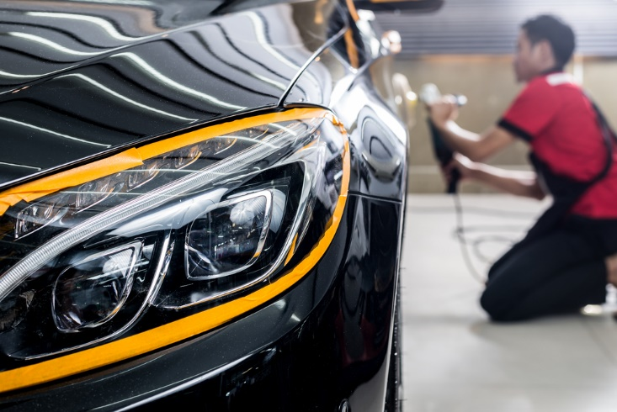
Customer Benefits
Consumers will get their cars cleaned at their own convenience and at the comfort of their homes and their business premises.
Among other benefits the consumers will also be enrolled in referral benefits program where they will receive extra credits for extra services.

Slide 10
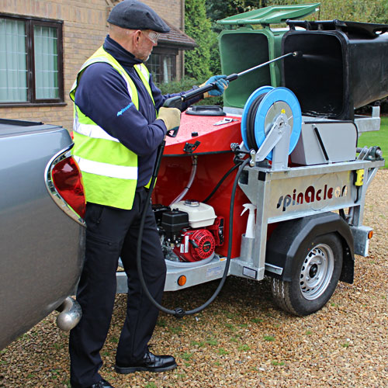
Operations
The business will be operated by the central office in headquarter.
The business will also delicate management of operation to regional managers and branch managers in their respective areas.
Operation will mainly include; the car was services and car dealership services.

Slide 11
Financials

Slide 12

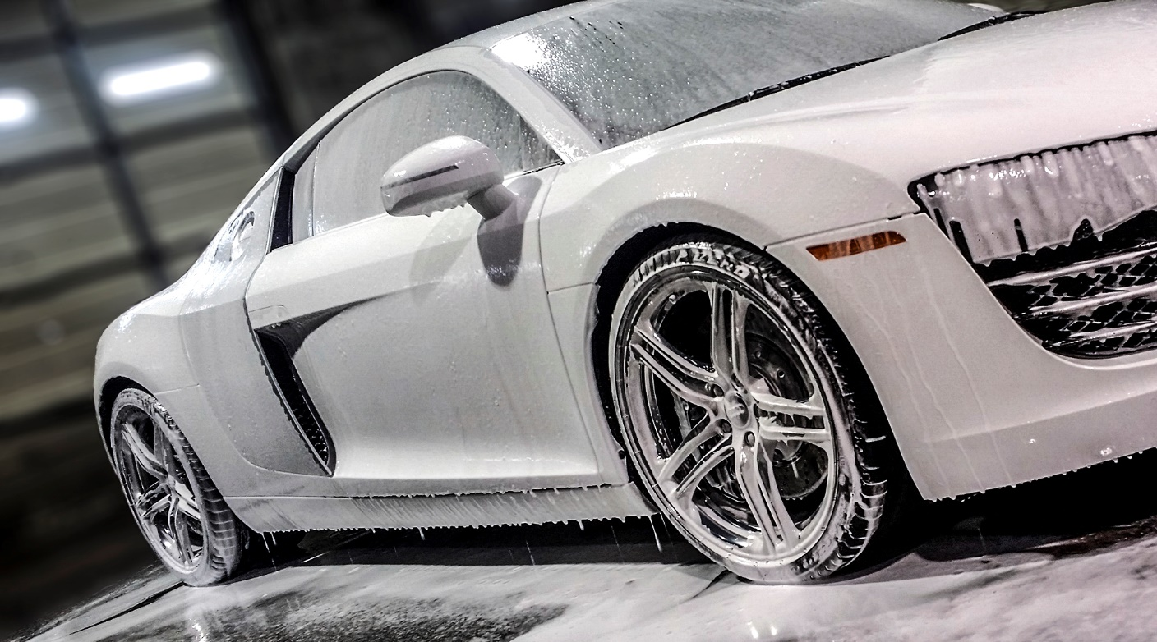
RISKS
Threat for new entries.
Copies of service by other competitors
Market failure.

Slide 13
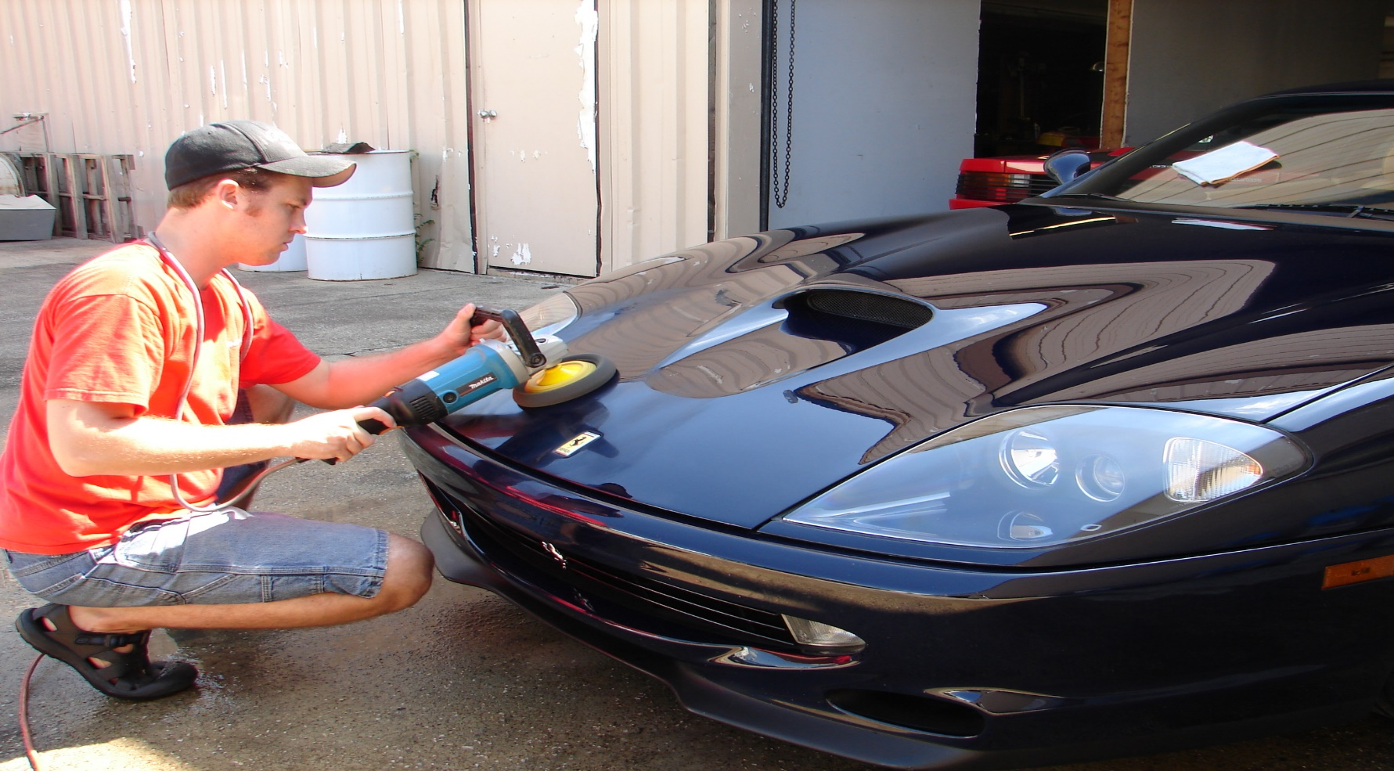
FINANCING
Shares will be sold to private owners at premium prices, and later a public offering will be issued for public.

